Slide 1
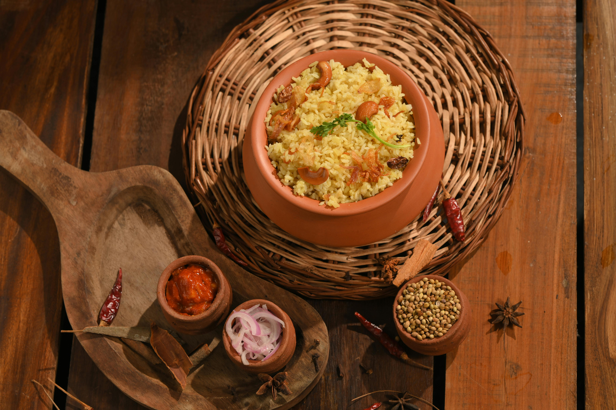


1
AX-WXXX BXXXXXX
BDM PROJECT
Reviving Online Sales: Addressing Order Decline in a Biryani Cloud Kitchen
Sharmila L
21f200XXXX

Slide 2
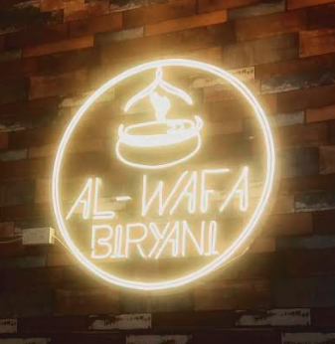
2
Startup's Recipe: Passion + Biryani
Ax‑Wxxx Bxxxxxxx, a cloud kitchen founded in April 2023 by Mrs. Rxxxxx Pxxxxxx, determined to fill the market gap by introducing Chennai’s signature flavor to Madurai with a focused, affordable menu.
Hero product: Regular Chicken Biryani at just ₹80
Operating hours: Daily from 11:30 AM to 3:00 PM
Team strength: 4 employees + master chef
Dine‑in capacity: 5 seats
Primary sales channels: Zomato/Swiggy deliveries
Liftime Orders [Apr2023-Dec2024]: 3220
Debt Free
Rental free
Developing Area , located in Main Road
Vision: Scale and become a huge brand like Behrouz Biryani

Slide 3



3
Problem Statement
Objectives
01.
Lack of Insight into Year-on-Year Growth
Fluctuations in Online Orders Impacting Business Sustainability
02.
Strategies to build long-term customer relationships and improve retention.
Menu optimization strategies to enhance customer conversions and boost order value.
Actionable branding strategies to strengthen market presence and drive business growth.
03.
Low Repeat Customer Rate Affecting Customer Base Growth
Customers
Operations
Delivery

Slide 4
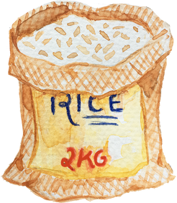


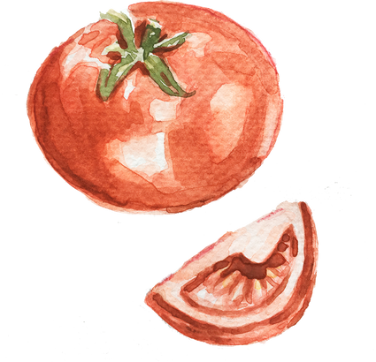


4
Ingredients That Shape The Future
Data
01.
Clean and Chop Chop!!
Dataset Timeframe/Type Source (#rows, #columns)
Removal of null values (NaN), ambiguous symbols (e.g., ‘?’), and irrelevant or redundant attributes
A derived binary feature for ‘Weekend vs Weekday, customer type, competitor type
Grouping orders into defined price ranges (below ₹200, between ₹200–₹299, and ₹300 or above)
Filters to isolate true competitors out of 246 listing
Reviews were categorized as positive(>=4), neutral(3), or negative(<=2) based on ratings
Categorized order items into logical groups (Biryani, Combo,Bucket, Starters, Drinks)
Added Lag features based on 7-day, 14-day seasonal cycles in autocorrelation plots
Log transformation for right skewed variables to control outliers
Sales History
Competitor Dataset
Detailed Order History
Customer Reviews
Other References
Apr 2023 to Feb 2025
-
Sept 2024 to Feb 2025
-
Article & Interviews
Zomato Merchant Dashboard (3317, 35)
Web Search results (246, 13)
Zomato Customer Care (1081,29)
Zomato Merchant Dashboard (47,2)
questionofcities.org, Owner & Staffs,
College schedule, Swiggy guidelines
02.
Analysis Methods & Objectives
Time Series Analysis - Understanding declining engagement, observe sales trends and weekend order peaks, while improving Operational efficiency
Menu Analysis - Optimize menu bundling and promotional decisions to improve average order value (AOV)
Customer Retention & Sentiment Analysis - Analyze customer spending patterns and pain points
Competitor Analysis - To understand broader market landscape and current positioning
Digital Performance Analysis - To understand digital storefront performance & brand image

Slide 5
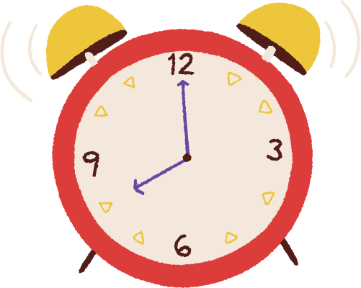

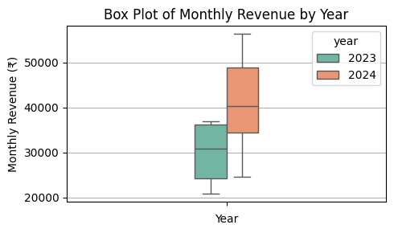
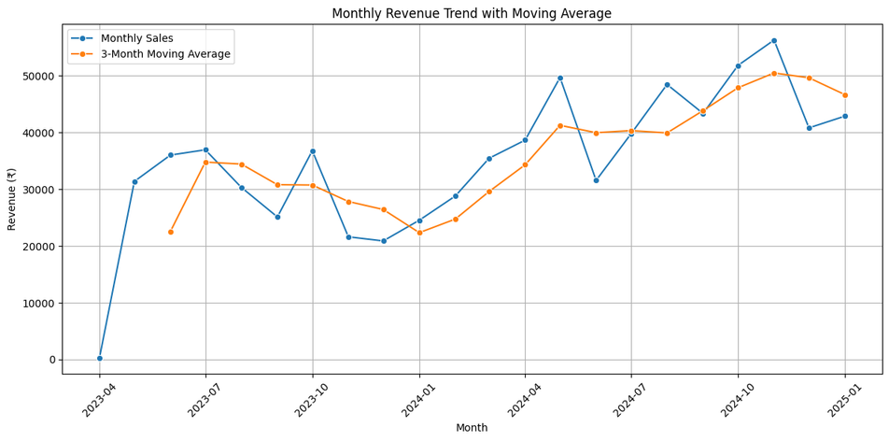


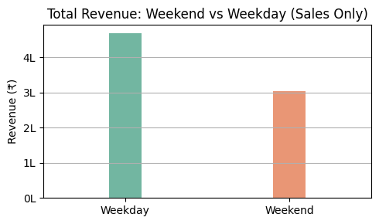
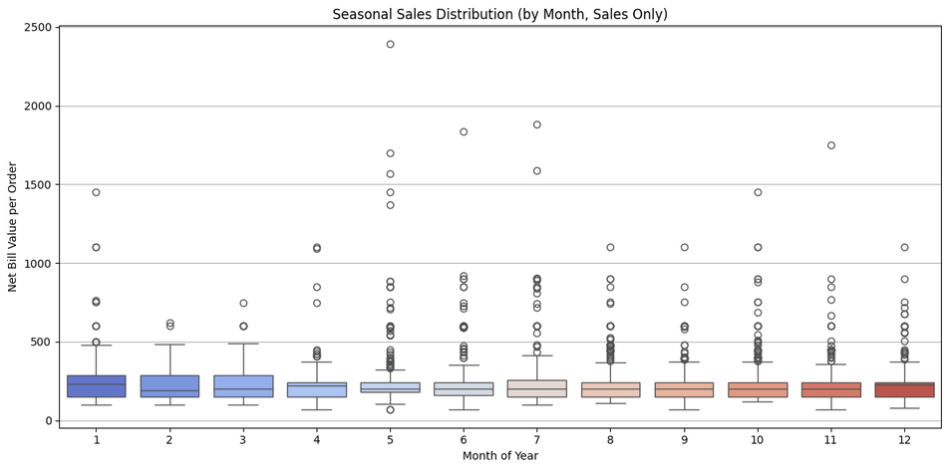
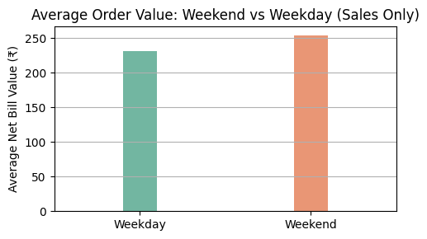
5
Time Series Analysis
[Apr 2023 - Jan 2025]
Average monthly revenue in 2023: ≈ 29,761
Average monthly revenue in 2024: ≈ 41,659
Annual Revenue Growth Rate ≈ 90%+
Average Bill Value: 210
Median Bill Value: 170
01. Assumptions/Beleifs by Owner
Business stagnation: Current performance is not as strong as during the 2023 opening.
Seasonal impact: December is the worst performing month due to the Ayyapan season.
Weekly trend: Sunday consistently shows higher business activity and is a busy day.
02. Key Observations
Sales stabilization and growth: Sales began stabilizing from April 2023 and displayed consistent growth throughout 2024, with average monthly revenue about 40% higher than in 2023.
Recurring sales pattern: A three-month cycle is visible, where sales typically rise for three consecutive months before dipping.
2023 baseline: The moving average hovers around ~30k, reflecting modest and uneven performance.
2024 uplift: The average line jumps sharply upward, stabilizing around ~42k–45k, confirming a structural shift.
Weekend dynamics: Weekends show higher Average Order Value (AOV) but fewer total sales.
Bill value stability: Bill values remain stable throughout the year, indicating reliable customer spending habits
Higher Outliers: Second half of the year has more outliers
Fig:1
Fig:4
03. Insights
Stable Median across all months
Seasonal dips explained: The dip in June and December aligns with college closures rather than festive reasons.
Performance uplift: An “average” month in 2024 outperformed the best month of 2023, showing business definitely stepped up and avoided uneven performance.
Stable bill values: This stability means growth is more volume‑driven than ticket‑size driven, pointing to opportunities in increasing orders rather than upselling.
Weekend traction: Sundays show particularly high traction. This could be leveraged by adding extended operating hours, Sunday-special offers, or unique experiences to attract more spending, especially from families and bulk orders.
Customer segmentation by day: Weekends tend to attract families, while weekdays are more popular among students and professionals.
Fig:2
Fig:3
Fig:5

Slide 6
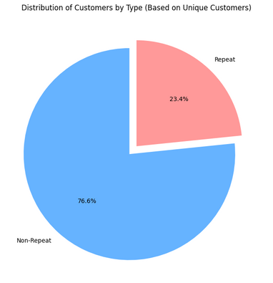
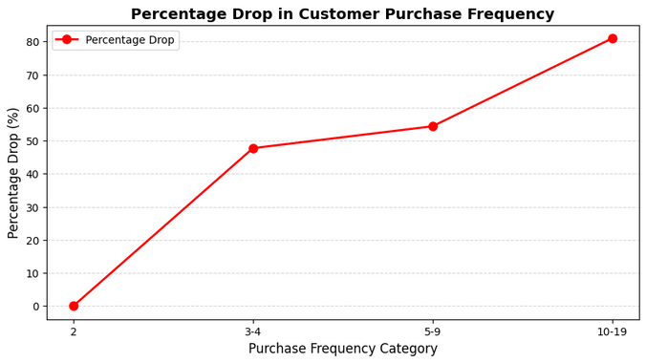
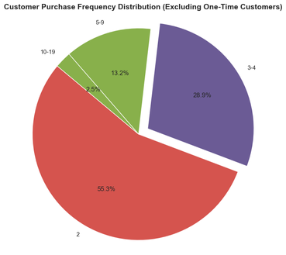
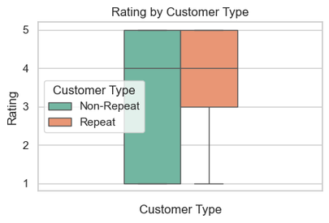
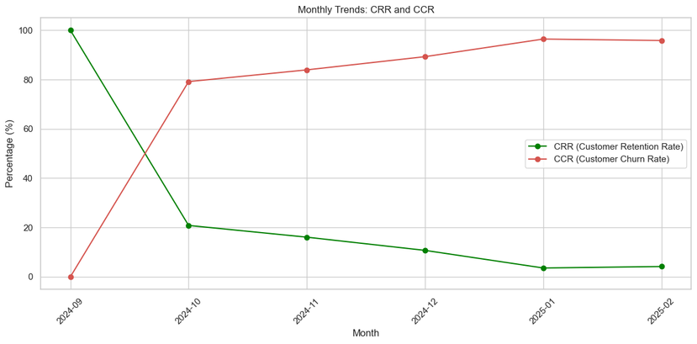
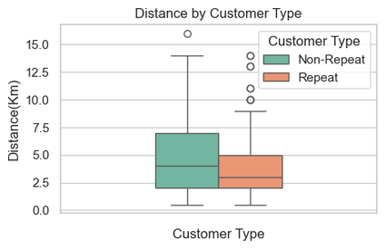
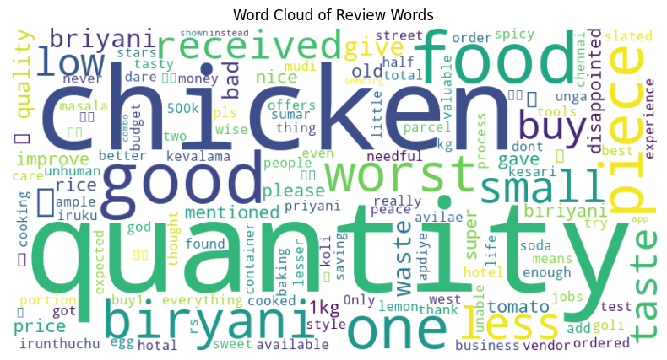
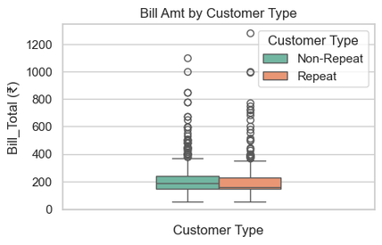
6
Retention Analysis
[Sept 2024 -Feb 2025]
Loosing Loyal Customers
01. Current Strategy in Place
Loosing potential loyal customer
The current retention method is simple:
Customers who call to place orders are added to a WhatsApp group.
The owner shares festive offer posters in the group to keep them engaged.
Occasional BOGO offers are run in limited quantities to avoid losses.
Fig:5
02. Observations
Fig:1
Repeat customers consistently give higher ratings.
Most repeat buyers order from within 2–4 km.
Non-repeat customers often from beyond 4 km likely place trial orders influenced by low price but don’t return.
Both customer types have similar bill distributions, but non-repeat customers show more outliers with high bills.
Customer retention is very low across months. By the end of February Customer Churn Rate reached 96.43% with steep between December to January.
Even among repeat buyers, 50% customers drop off after 2-3 purchases who could likely become loyal customer in future.
Most negative mentions are linked to portion size accuracy(40%), taste consistency(30%), and wrong or incomplete orders(10%).
Although sentiment clusters featured keywords like “tasty,” “good,” and “delicious,” the proportion of negative experiences indicates a need for operational refinement.
Fig:6
Fig:2
03. Insights
Fig:7
Retention: Churn is extremely high (96%), with many customers dropping off after 2–3 purchases. Positive experiences, consistency, and trust-building are critical to keep them engaged.
Distance: Repeat buyers are mostly within 2–4 km. Longer distances cause delays, anticipation, and food temperature issues, leading to trial-only customers who don’t return.
Operations: Negative mentions focus on portion size accuracy, taste consistency, and incomplete orders. Addressing these operational gaps is essential to reduce dissatisfaction
Customer Segmentation: Weekends attract families (higher AOV, bulk orders), while weekdays are driven by students and professionals. Tailored offers for each segment can maximize traction.
Fig:3
Fig:4
Fig:8

Slide 7

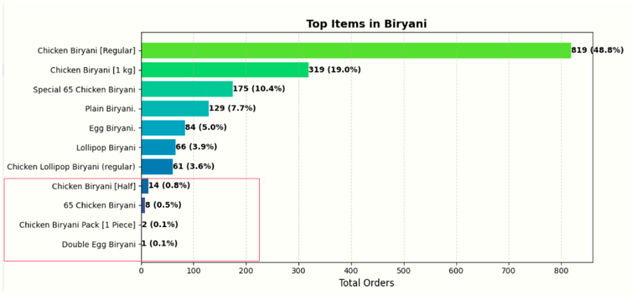
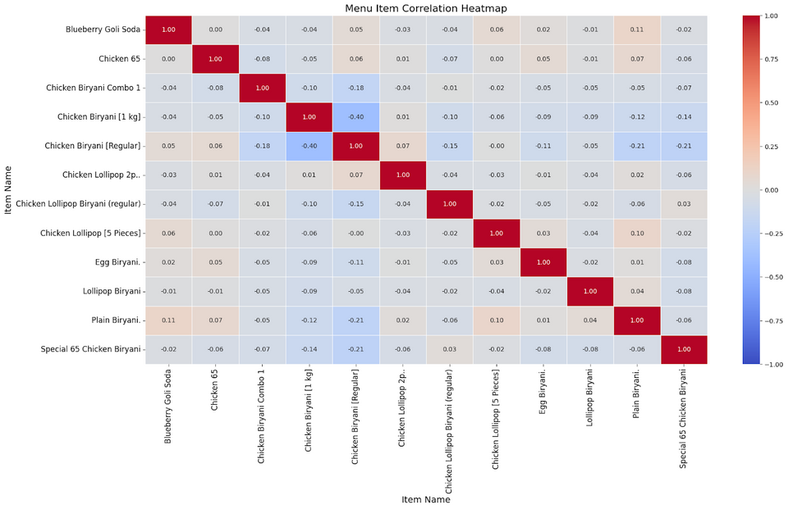


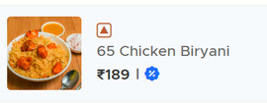
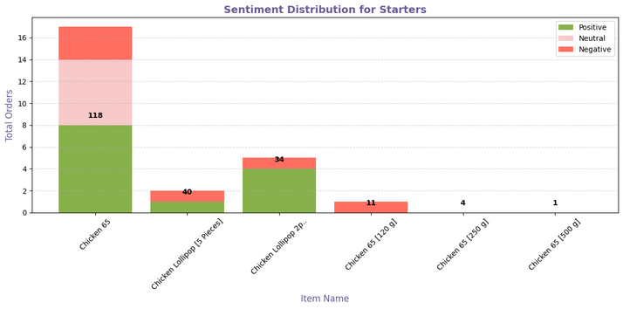
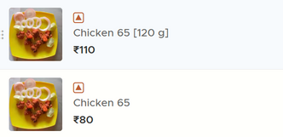
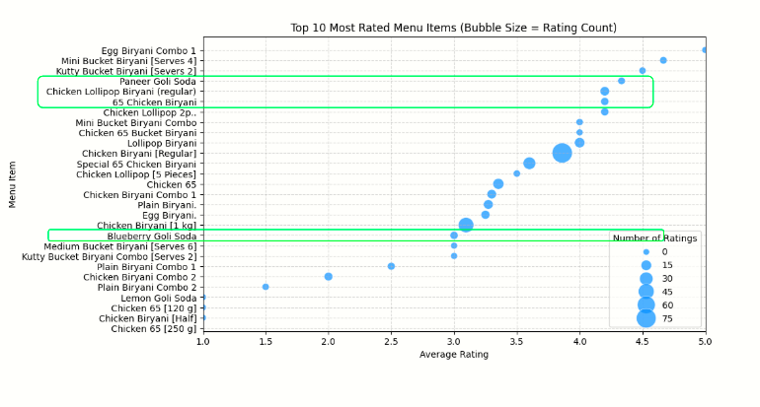
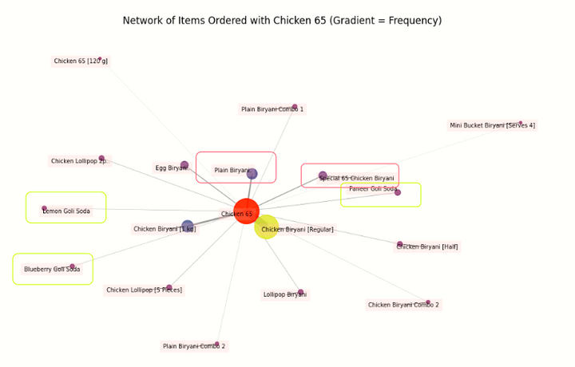

7
Menu Analysis
Biryani Category - Regular chicken Biryani
Starters - Chicken 65
Combo - Combo 1
Drinks - Blueberry Goli Soda
01. Observations
Top performers are Chicken Biryani [Regular] and Chicken Biryani [1 kg], with starter Chicken 65.
Chicken Biryani Pack (1 Piece), Double Egg Biryani, and Chicken Biryani (Half) showed negligible demand and limited positive sentiment.
Closely priced variants appear to cannibalize each other without boosting overall sales, suggesting scope for rationalization.
Customers ordering Chicken 65 Biryani often added an extra serving of Chicken 65, showing strong loyalty to that flavor profile.
Lollipop have better rating than Chicken 65
When Chicken 65 was ordered, demand for soft drinks dropped considerably.
Paneer Goli Soda, though lower in sales, consistently maintained ratings above 4, while Blueberry Goli Soda had lower average ratings, often below 3.
Fig:1
02. Insights
Price sensitivity: Customers prefer familiar, value-driven variants, highlighting the need to keep pricing sharp.
SKU rationalization: Streamlining low-performing items can simplify kitchen workflow and focus on high performers.
Portion perception: Same photos and vague descriptions across portions create mismatches, driving inconsistent ratings.
Menu correlation: Weak relationship between Regular Chicken Biryani and Chicken 65 shows one does not predict the other.
Innovation opportunity: Strong preference for Chicken 65 signals scope for data-informed menu innovation around this flavor.
Brand monitoring: Paneer & Blueberry Goli Soda belong to different brands, requiring periodic checks for quality consistency.
Seasonal beverages: Warm alternatives like soups in colder months can sustain add-on sales volume.
Recipe refinement: None of the top 6 items have achieved 4+ ratings, indicating room for improvement in taste or presentation.
Add-on potential: Lollipop shows strong promise when paired with biryani orders.
Fig:4
Fig:2
Fig:5
Fig:3

Slide 8
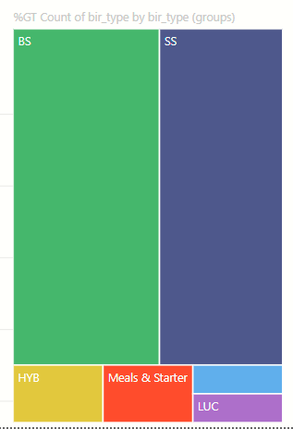
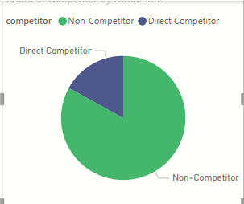

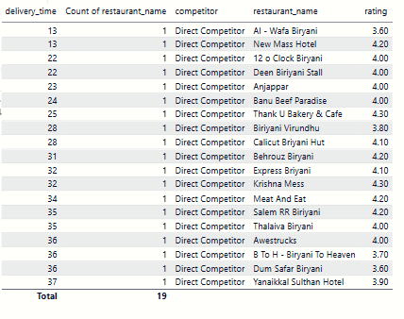
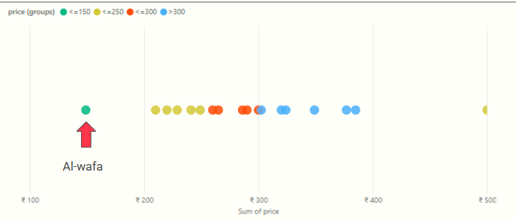
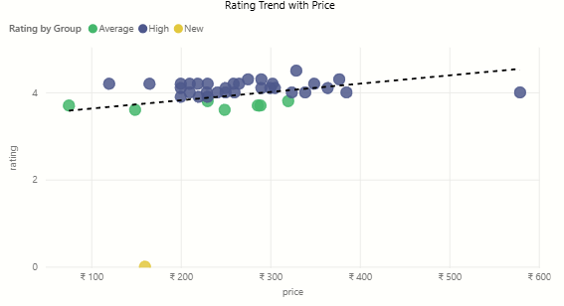
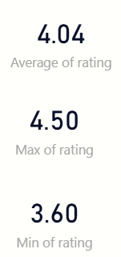
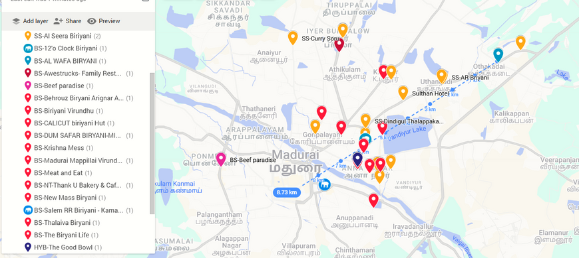
8
Competitor Analysis
01
Assumptions/Beleifs
Market dominance: Seerga Samba and Dindigul Style Biryani are the leading categories, with little presence of Basmati Biryani.
Unique price positioning: No competitors currently match their price offerings, with the hero item selling at Rs.80.
Fragmented market
Al-Wafa
02
Observations
46% of restaurants on Zomato in Othakadai, Madurai also serve Basmati Biryani.
41 direct competitors identified with traits: selling Basmati Biryani, budget best sellers (< ₹400), delivery times under 40 minutes, and app search ranks within the top 150.
No restaurant found with a rating below 3, showing stable satisfaction levels.
Al-Wafa is the only restaurant priced below ₹200, while most competitors price above ₹200.
Concentrated competitor clusters are located ~5 km away from Al-Wafa.
Fig:1
Fig:2
(In Rupees)
Average: >=3 and <4
High >=4
3.6
Al-Wafa
Insights
03
Competitive intensity: The segment is more competitive than initially assumed, highlighting the need for differentiation.
Positioning balance: Affordability offers a competitive edge for value-driven customers, but satisfaction must align with price perception to avoid being seen as merely “budget.”
Competitor ratings: Rivals maintain more stable average ratings due to higher review volumes, signaling stronger consistency.
Local operations: Since most customers are within 2–5 km, ensuring sufficient driver presence in this zone is crucial to reduce delays and maintain reliability.
Fig:3
Fig:4
Competitor Hotspot 5km from Al-Wafa
Fig:5

Slide 9

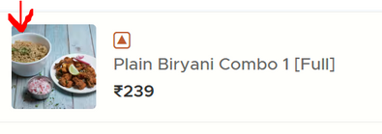
9
Collectively, these findings highlight the need for customer experience enhancement, digital storefront, menu optimization, and local ecosystem strengthening to improve retention, reputation, and operational efficiency
Recommendations
You Get what you see
Strategic offers
LONG TERM RELATIONSHIPS
CONSISTENCY & CLARITY
Stabilize weekday performance through targeted promotions for nearby workplace and institutional clusters, such as the Madurai Court and surrounding colleges.
Offer Friday Group Bookings to promote Combos & bucket orders like "Taste better with Friends", BOGO Offers. Avoid running offers for low value orders.
Launch result-based student discounts (e.g., “Score 80%? Get 20% Off!”) to build emotional engagement and encourage call-to-order to reduce aggregator dependencies.
Standardize taste and portion sizes
Clarify portion sizes and servings:
Clearly indicate both weight (e.g., 250g, 500g, 1kg) & serving size (e.g., “Serves 1,” “Serves 2–3”) in the item descriptions.
For side dishes like Chicken 65, specify the number of pieces and ensure images match the stated portion.
Avoid using identical images for different portion sizes, as it misleads customers.
Update high quality images that match the actual offering precisely and avoid no image listings, half filed portion images
Innovate & Adapt
I am different
CUSTOMIZE TO CAPTURE
INDENTITY & RECALL
Develop and test a “Double Chicken 65 Special” combo meal based on strong customer preference data.
Track seasonal consumption trends (e.g., reduced soft drink demand in winter) and adjust the menu accordingly such as introducing soups or warm beverages during colder months.
Drop low performing items from the Menu periodically and maintain focused menu
Chennai identity in menu: Incorporate local slang and explicitly mention “Chennai Biryani” in item names and descriptions for stronger regional recall (e.g., “Singaara Samayal Chennai Biryani – vera level aroma, semma tasty da!”).
Loyalty gestures: Surprise loyal customers with goodwill touches (extra portions, personalized notes, or small freebies) to strengthen retention and trust.
Branded packaging: Introduce distinctive food packaging to reinforce brand presence
Engagement
Make the most of it
OPERATIONAL RELIABILITY
PROMOTE & UPSELL
Al-Wafa can take small, practical steps to build a more supportive local ecosystem:
Comfort zone setup: Establish shaded seating and mobile charging points to encourage delivery partners to stay nearby during peak hours, improving pickup efficiency and reducing delays.
Personalized engagement: Add printed or handwritten rating encouragement notes or personalized messages in digital receipts to increase post-order engagement.
Review etiquette: Be polite when responding to negative reviews and reply to positive reviews as soon as possible.
Promote sodas & side dishes as add-on recommendations in app alongside relevant food pairings using a “Tastes Better With” tag for better contextual appeal specially with Plain Biryani.
Highlight Paneer Goli Soda’s strong customer ratings in promotional visuals to reinforce positive sentiment and drive choice confidence.
Periodically monitor Blueberry Goli Soda’s brand reputation and sensory alignment through in-store feedback and controlled taste checks to ensure product experience remains consistent with customer expectations.
Explore Swiggy features as well and avoid over dependance on just Zomato

Slide 10
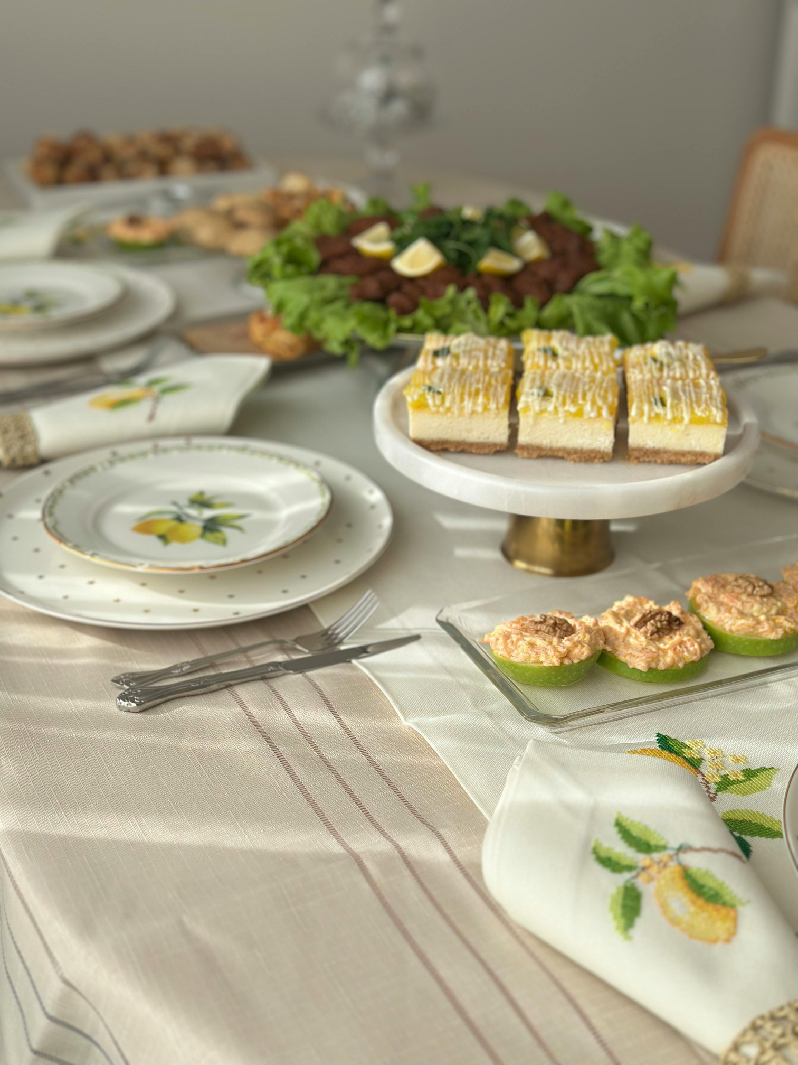

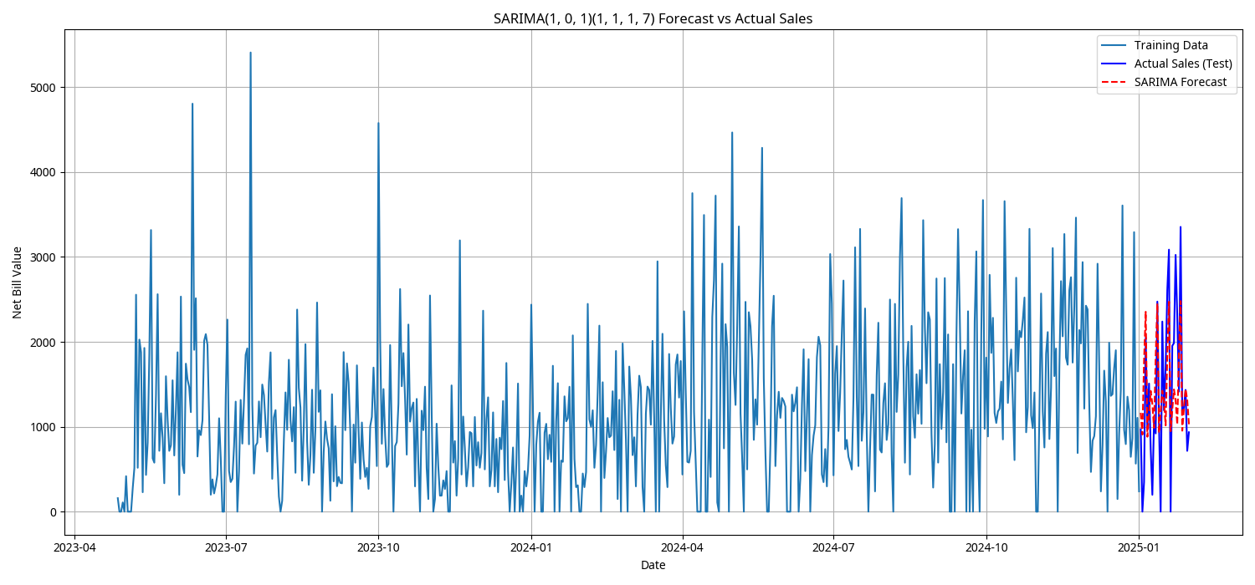


10
FUTURE OPPORTUNITIES.
Develop a reliable forecast model with better exogenous variables like climate and local activity to efficiently plan operations, reducing dependency on aggregator-shared data.
Maintain income and expense reports using a simple Google Sheet for better financial tracking.
Conduct periodic staff training to ensure smooth order handling without hiccups.
Extend operating hours on Sundays to attract more sales and increase customer engagement.
Mean Absolute Error (MAE) of 594.94 and a
Root Mean Squared Error (RMSE) of 748.32, suggesting that daily forecasts deviated by approximately ₹600–₹750 on average.
Thank You!

